Slide 1
Messaging Protocols
Unit 2
Subject : Intelligent System and Security
Course : M.Tech. AIDS – SEM2

Slide 2

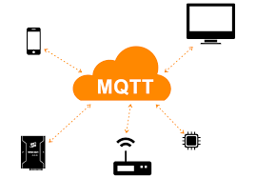
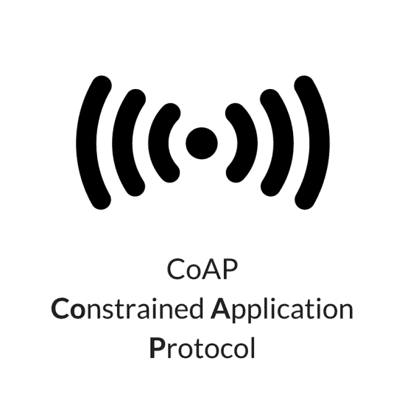

Messaging Protocols in IoT
Messaging protocols are very important for the transfer of data in terms of messages.
They are useful for send/receive of a message to/from the cloud in IoT applications.
In the section, two messaging protocols are discussed.
Message Queuing Telemetry Transport (MQTT)
Constrained Application Protocol (CoAP)
Extensible Messaging Presence Protocol(XMPP)

Slide 3


Message Queuing Telemetry Transport (MQTT)
As we know, IoT has one of the biggest challenges of resource constraints, the lightweight protocol is more preferred.
MQTT is widely used in IoT applications as it is a lightweight protocol.
Here, lightweight means, it can work with minimal resources and does not require any specific hardware architecture or additional resources.

Slide 4
Communication model
Request-Response communication model
Publish-Subscribe communication model
Push-Pull communication model
Exclusive Pair communication model

Slide 5
MQTT
MQTT works with “publish – subscribe” pattern.
The MQTT working can be explained as follows.
The publisher (node) sends a message to the MQTT broker.
The MQTT broker transmits the message to the subscribed destinations.
Subscriber
Publisher
MQTT Broker
Subscriber

Slide 6




MQTT - Example
Suppose a temperature sensor is connected to any system and we want to monitor that temperature.
The controller connected to the temperature sensor publishes the temperature value to the MQTT broker with a topic name: “Temperature”. Hence, it is considered a publisher.
The MQTT broker transmits the temperature value to the subscribers.
Note that the only nodes which have subscribed to the topic will capture the data and not the other nodes.
Subscriber 1
Subscribed to:
“Temperature”
Subscriber 2
Publisher
MQTT Broker
Subscribed to:
“Temperature”
Subscriber 3

Slide 7


MQTT - Example
Can publisher and subscriber interchange their role?
Let us take an example of a Driverless car.
A GPS sensor is connected to the car which gives the current location of the car.
The system in car, publishes the location to MQTT broker with topic name – CurrentLocation.
The server/computer subscribes to the topic CurrentLocation and receives the current location of the car.
Publisher: CurrentLocation
MQTT Broker
Subscriber: CurrentLocation

Slide 8
MQTT - Example
Based on the currently selected destination, the server/computer computes the direction of the car.
This data is published to an MQTT broker with a topic named – Direction.
To get the command from the server, the system in the car has to subscribe to the topic named Direction.
According to the command received from the server, the car will run in a particular direction.
Publisher: CurrentLocation
MQTT Broker
Subscriber: CurrentLocation
Subscriber: Direction
Publisher: Direction

Slide 9


MQTT - Working
In MQTT, clients do not have any address like a typical networking scheme.
The broker filters the messages based on the subscribed topics.
The messages will then be circulated to respective subscribers.
The topic name can be anything in string format.
The MQTT working can be explained with an example of the television broadcast.
Client_Address

Slide 10





MQTT - Working
Television broadcaster station broadcasts all the channels.
The viewers subscribe to their favorite channels only.
Similarly, in MQTT, the publisher node publishes data with the topic name and interested subscribers subscribe to the topic.
Note that there can be multiple subscribers of a same topic as well as a single subscriber can subscribe to multiple topics.

Slide 11

MQTT – Node(s)
Node(s) in MQTT collects the information from sensors or other i/p devices in case of the publisher.
Connects it to the messaging server known as the MQTT broker.
A specific string – Topic is used to publish the message and let other nodes understand the information. These nodes are considered subscribers.
Any node can be publisher or subscriber and node is also referred to as client.
Publisher
MQTT
Broker
Subscriber
Topic:SensData

Slide 12
QoS in MQTT
MQTT supports different QoS (Quality of Service) levels.
There are 3 layers of QoS supported by MQTT.
At most once (QoS 0): No Guarantee of Message Transmission
At least once (QoS 1): One Message is Guaranteed.
Exactly once (QoS 2): Handshake Mechanism Between the Sender and Receiver.
QoS 0 - At most once: Messages are delivered according to the best efforts of the operating environment. There is no guarantee of delivery. A message may be lost, and this is the fastest QoS level.
QoS 1 - At least once: The message is assured to arrive, but it may arrive more than once. The sender stores the message until it gets an acknowledgment from the receiver.
QoS 2 - Exactly once: This is the highest level of service. The message is assured to arrive exactly once. It involves a four-step handshake process between sender and receiver.

Slide 13
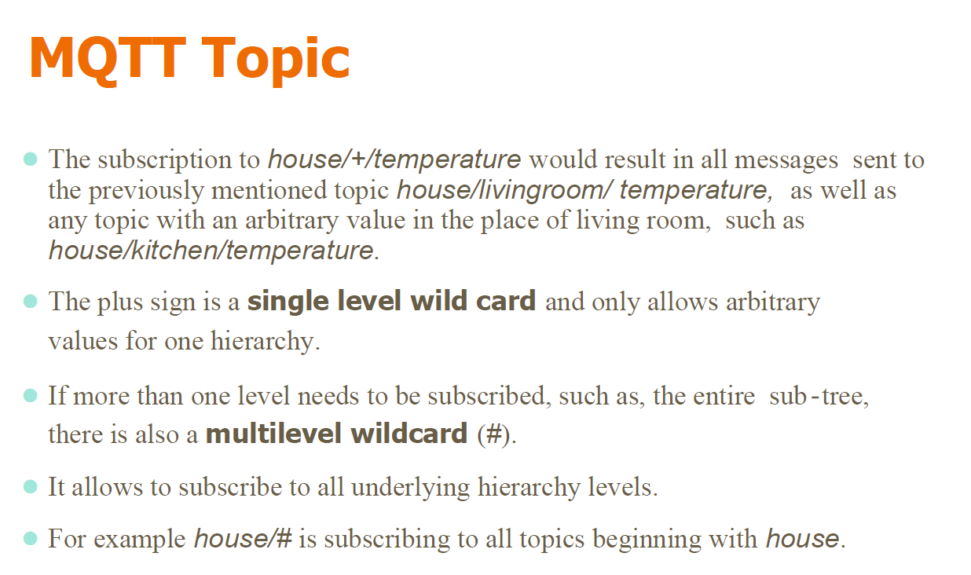

Slide 14
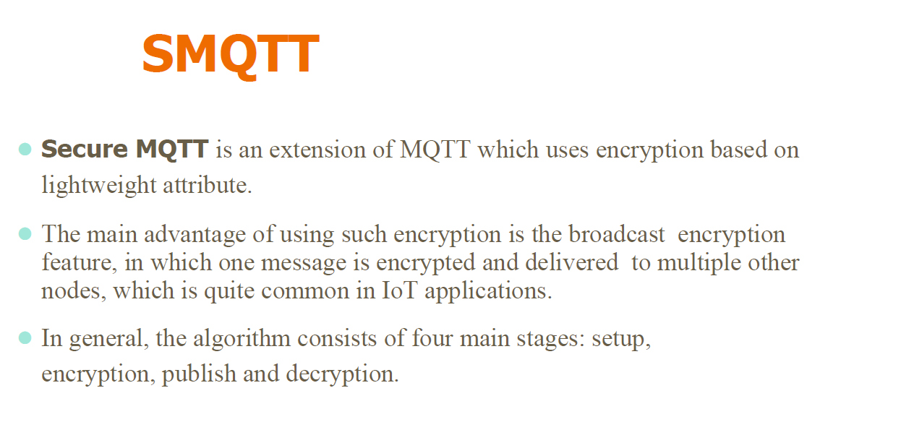

Slide 15
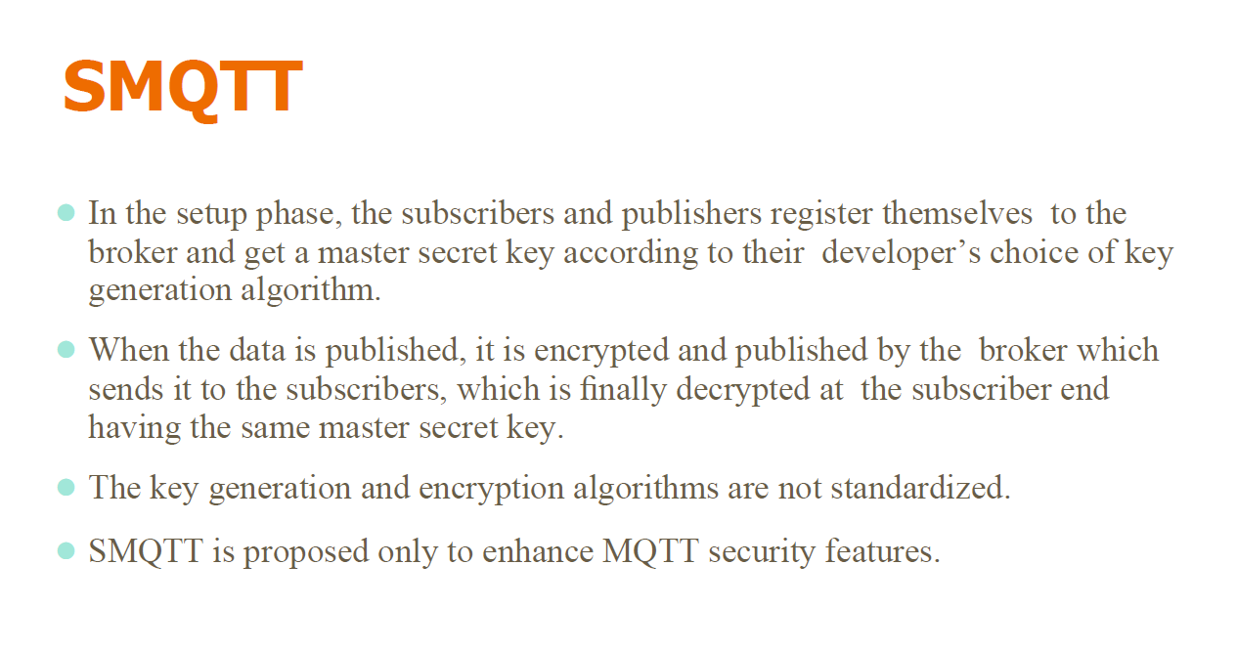

Slide 16
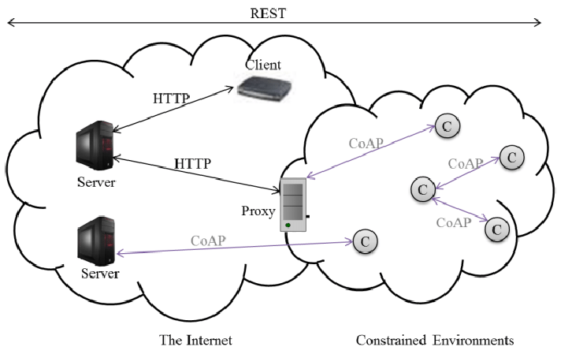
Constrained Application Protocol (CoAP)
CoAP is designed by IETF (Internet Engineer Task Force) to work in constrained environment.
It is a one-to-one communication protocol.
CoAP is also light weight like MQTT protocol, and it uses less resources than HTTP.
HTTP runs over TCP and is connection oriented while CoAP runs over UDP and it is connection less.

Slide 17
CoAP Architecture
CoAP is based on the RESTful architecture (Representational State Transfer).
REST approach ensures the secure, fault tolerant and scalable system.
The CoAP optimizes the length of the datagram.
CoAP is connectionless protocol and it requires retransmission support.

Slide 18
CoAP Layers
CoAP has four layers:
UDP
Messages
Request-Response
Application
The message layer is designed to deal with UDP and asynchronous switching.
The request/response layer concerns communication method and deal with request/response messages.
In the request/response layer, clients may use GET/PUT/DELET methods to transmit the message.
Application
Request/Response
Messages
UDP

Slide 19
Message Layer in CoAP
CoAP message layer supports four types of messages:
Confirmable – Reliable Messaging (CON)
Non-confirmable – Non-reliable Messaging (NON)
Acknowledgement (ACK)
Reset (RST)

Slide 20
Message Layer in CoAP
CoAP message layer supports four types of messages:
Confirmable – Reliable Messaging (CON):
This is reliable approach because the retransmission of message occurs until the acknowledgement of the same message ID is received.
If there is a timeout or fail of acknowledgement, the RST message will be sent from the server as a response.
Hence, the client will retransmit the message, this resolves the retransmission and it is considered a reliable approach.
Client
Server
CON (ADDR)
ACK (ADDR)

Slide 21
Message Layer in CoAP (Contd.)
Non-confirmable – Non-reliable Messaging (NON):
In this message transmission style, there is no reliability is ensured.
The acknowledgement is not issued by the server.
The message has ID for supervision purpose, if the message is not processed by the server it transmits the RST message.
Client
Server
NON [Message ID]

Slide 22
Message Layer in CoAP (Contd.)
Acknowledgement (ACK):
In this messaging, the traditional acknowledgement message sent as usual protocol.
We can compare this with regular handshaking scheme.
The handshake is automated process that establishes a link for communication before actual data transfer begins.
Client
Server
CON (ADDR)
ACK (ADDR)

Slide 23
Message Layer in CoAP (Contd.)
Reset (RST):
The receiver is expecting the message from sender of a particular message ID.
If no message is processed or received before specific amount of time (called timeout), the message called RESET is transmitted from receiver.
This message informs the sender that there is a trouble in transmission of messages.
Client
Server
CON (ADDR)
Timeout
RST

Slide 24
Request-Response Layer in CoAP
There are three modes in CoAP request-response layer.
Piggy-Backed:
In this mode, the client sends the data with particular method (GET, PUT etc.) with token number and CON/NON messaging method.
The ACK is transmitted by server immediately with corresponding token number and message.
If the message is not received by server or data is not available then the failure code is embedded in ACK.
Client
Server
Client
Server
CON (ADDR)
GET/Humidity
(Token Number)
CON (ADDR)
GET/Humidity
(Token Number)
ACK (ADDR)
(Token Number)
NOT FOUND
ACK (ADDR)
(Token Number)

Slide 25
Request-Response Layer in CoAP (Contd.)
Separate Response:
In this mode, the client sends the data with particular method (GET, PUT etc.) with token number and CON messaging method.
If the server is unable to respond immediately, an empty ACK will be reverted.
After some time, when the server is able to send the response, it sends a CON message with data.
In response to that, ACK is sent back from client to server.
Client
Server
CON (ADDR)
GET/Humidity
(Token Number)
ACK
.
.
.
.
CON (ADDR)
(Token Number)
ACK

Slide 26
Request-Response Layer in CoAP (Contd.)
Non-Confirmable Request and Response:
In this mode, the client sends the data with particular method (GET, PUT etc.) with token number and NON messaging method.
The server does not give ACK in NON messaging method, so it will send a NON type response in return with token number and its data.
Client
Server
NON (Message ID)
GET/Humidity
(Token Number)
NON (Message ID)
(Token Number)

Slide 27
CoAP Message Format
The CoAP message format is of 16 Bytes consisting various fields.
V : It refers to version of CoAP. It is two bit unsigned integer.
T : It refers to message type. It is also two bit unsigned integer.
Confirmable (0)
Non-Confirmable (1)
ACK (2)
RESET (3)
TKL : It refers to the token length and is four bit unsigned integer.
Code: It refers to the response code.
0 | 1 | 2 | 3 | 4 | 5 | 6 | 7 | 8 | 9 | 10 | 11 | 12 | 13 | 14 | 15 | 16 | 17 | 18 | 19 | 20 | 21 | 22 | 23 | 24 | 25 | 26 | 27 | 28 | 29 | 30 | 31
V | T | TKL | Code | Message ID
Token (if any, with TKL bytes length)
Options (if any)
1 | 1 | 1 | 1 | 1 | 1 | 1 | 1 | Payload

Slide 28
CoAP Message Format (Contd.)
Message ID: It is identifier of the message and to avoid duplication.
Token : Optional field whose size is indicated by the Token Length field.
Options : This field is used if any options available and having length of 4 Bytes.
Payload : This field refers to the payload data where actual data is transmitted.
0 | 1 | 2 | 3 | 4 | 5 | 6 | 7 | 8 | 9 | 10 | 11 | 12 | 13 | 14 | 15 | 16 | 17 | 18 | 19 | 20 | 21 | 22 | 23 | 24 | 25 | 26 | 27 | 28 | 29 | 30 | 31
V | T | TKL | Code | Message ID
Token (if any, with TKL bytes length)
Options (if any)
1 | 1 | 1 | 1 | 1 | 1 | 1 | 1 | Payload

Slide 29
Difference between MQTT & CoAP
 | MQTT | CoAP
Underlying protocol | TCP (connection oriented) | UDP (connectionless)
Communication | M:N (Many to many) | 1:1 (One-to-one)
Power | Higher than CoAP. Lesser than other protocols. | Lowest, consumes less power than MQTT, making it the best for point to point communication.
Model | Publisher/Subscriber | Request-response (RESTful)

Slide 30


XMPP Protocol
The full form of XMPP is Extensible Messaging and Presence Protocol.
It is designed for messaging, chat, video, voice calls and collaboration.
The fundamental base of this protocol is XML and it is used for messaging services such as WhatsApp.
The XMPP was originally named as Jabber and later known as XMPP.

Slide 31
XMPP denotation
The denotation for XMPP can be given as following:
X – X denotes eXtensible.
It is considered extensible as it is designed to accept and accommodate any changes.
The protocol is defined in open standard and it is extensible because of open standard approach.
M – M denotes Messaging.
XMPP supports sending message to the recipients in real time.
P – P denotes Presence.
It is helpful to identify the status such as “Offline” or “Online” or “Busy”.
It also helps in understanding if the recipient is ready to receive the message or not.
P – P denotes Protocol.
The set of standards together acting as a protocol.

Slide 32
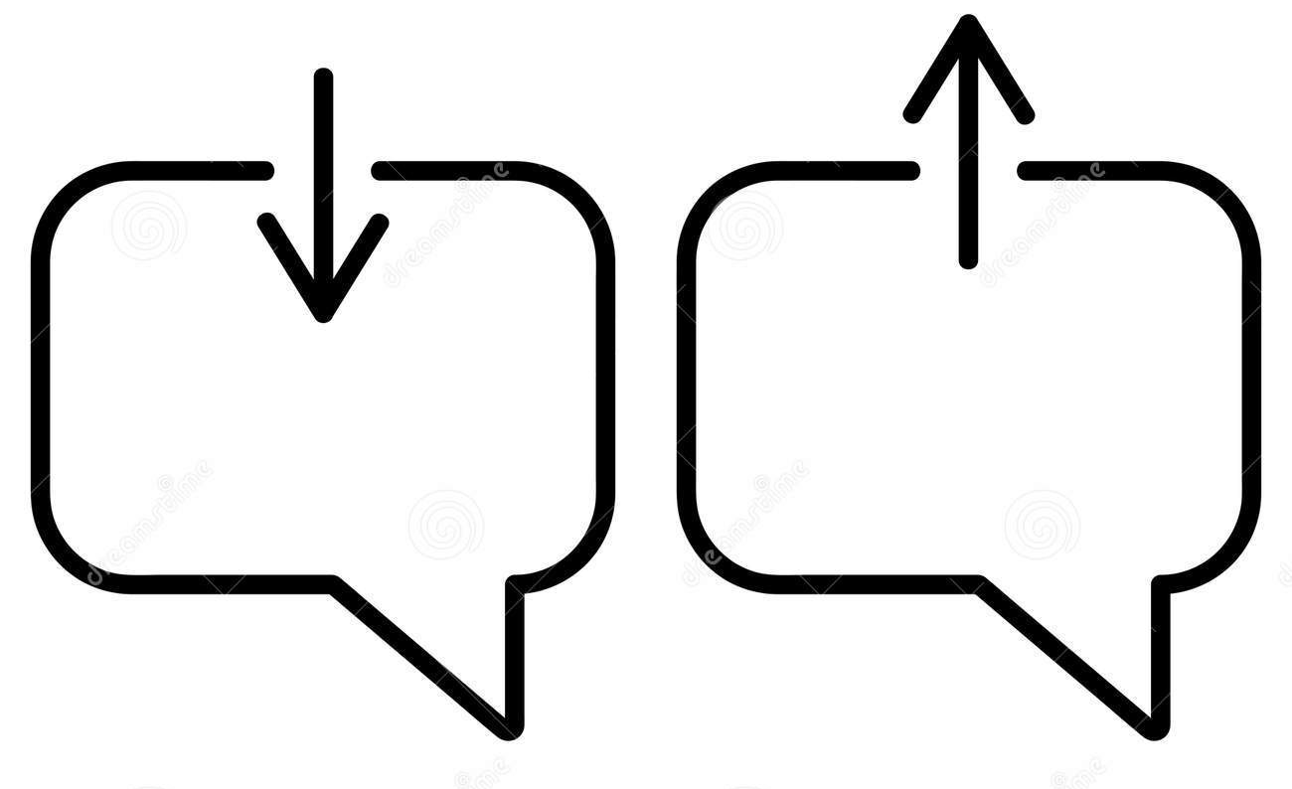




Messenger Requirements
Any messenger requires the following features inbuilt :
Message sending and receiving features.
Understanding the presence/absence status.
Managing subscription details.
Maintaining the contact list.
Message blocking services.
Note that all the listed features are built in XMPP.

Slide 33
XMPP Features:
The following are features of XMPP:
Decentralized: XMPP is similar to that of e-mail. Anyone can run their own XMPP server.
Secure: XMPP is very secure with end-to-end encryption.
Stable & functionally proven: It is functionally proven since its initial version Jabber launched in 1998.
Standardization: IETF published XMPP specifications as RFCs in RFC3920 & 3921 standards.
Flexibility: XMPP is not just messaging oriented; it is flexible enough for file sharing, gaming & even remote monitoring of systems.

Slide 34
XMPP Architecture
The architecture of XMPP protocol is shown in the figure :
The XMPP clients communicate with XMPP server bidirectional.
There can be any numbers of clients connected to XMPP server.
The XMPP servers may be connected to the other clients or other XMPP servers.
XMPP
Client
XMPP
Client
XMPP
Client
XMPP
Server
XMPP
Server
XMPP
Client
XMPP
Client
XMPP
Client

Slide 35
XMPP Architecture (Contd.)
The initial version of the XMPP was with TCP using open ended XML.
After certain period of time, the XMPP was developed based on HTTP.
The XMPP can work with HTTP through two different methods Polling and Binding.
What is Polling and Binding?
XMPP
Client
XMPP
Client
XMPP
Client
XMPP
Server
XMPP
Server
XMPP
Client
XMPP
Client
XMPP
Client

Slide 36
XMPP Architecture (Contd.)
In polling method, the messages stored in the server are pulled or fetched.
The fetching is done by XMPP client through HTTP GET and POST requests.
In binding method, Bidirectional-streams Over Synchronous HTTP (BOSH) enables the server to push the messages to the clients when they are sent.
The binding approach is more effective than polling.
Also both method uses HTTP, hence the firewall allows the fetch and post activity without any difficulties.

